Slide 1
CPT-S 415
Big Data
Yinghui Wu
EME B45

Slide 2
CPT-S 415
Big Data
Relational data: design and query
Design of relational data models
  functional dependencies
  the normal forms 1NF, 2NF, 3NF, BCNF
Relational Algebra
Notes:
Object.

Slide 3
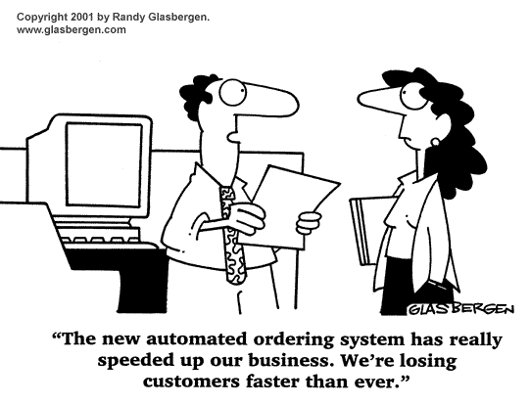
Design relational data model for Big Data

Slide 4
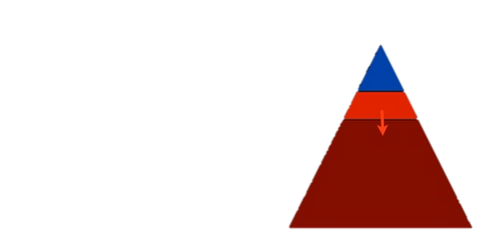
A Big Data Fallacy
“Data model Design in the era of Big data is less important” (?)
  New high-volume data streams
  specialized hardware/softwares
  Storage issues coped by hardware appliance
Fact:
  Most data is physically located in DBMS and new special-purpose appliance
  Data loads, extract, transform, preprocessing ops continue as is
  Database design for quality assurance
Big data a necessity at Largest Scale
MySQL, Oracle, Mongo, Cassandra,
some memcache,
Some Hadoop…
A certain kind of developer at
a certain kind of company
Most development still RDBMS

Slide 5
Relational Databases Design
Relational database design: The grouping of attributes to form "good" relation schemas
We have assumed schema R is given
  R could have been a single relation containing all attributes that are of interest (called universal relation).
  Normalization breaks R into smaller relations.
  R could have been the result of some ad hoc design of relations, which we then test/convert to normal form.

Slide 6
Normalization

Slide 7
Introduction to Normalization
Normalization: Process of decomposing unsatisfactory "bad" relations by breaking up their attributes into smaller relations
Normal form: Condition using keys and functional dependencies (FDs) of a relation to certify whether a relation schema is in a particular normal form
  2NF, 3NF, BCNF based on keys and FDs of a relation schema
  4NF based on keys, multi-valued dependencies
    Normal form (1NF)
    Second normal form (2NF)
    Third normal form (3NF)
    Boyce-Codd Normal Form (BCNF)
stronger
guarantees

Slide 8
The Need for Normalization
Mixing attributes of multiple entities may cause problems
  Information is stored redundantly wasting storage
  Problems with update anomalies:
    Insertion anomalies
    Deletion anomalies
    Modification anomalies
The report may yield different results, depending on data anomaly
  Primary keys?
  Data redundancy
  Possible data inconsistencies: JOB_CLASS: Elect.Engineer, Elect.Eng. El.Eng. EE

Slide 9
The Need for Normalization
For most business database design, 3NF is highest we need to go in the normalization process
  Highest level of normalization is not always most desirable
Normalization should be part of design process
  Make sure that proposed entities meet required normal form before table structures are created
  Many real-world databases have been improperly designed or burdened with anomalies if improperly modified during course of time
  You may be asked to redesign and modify existing databases

Slide 10
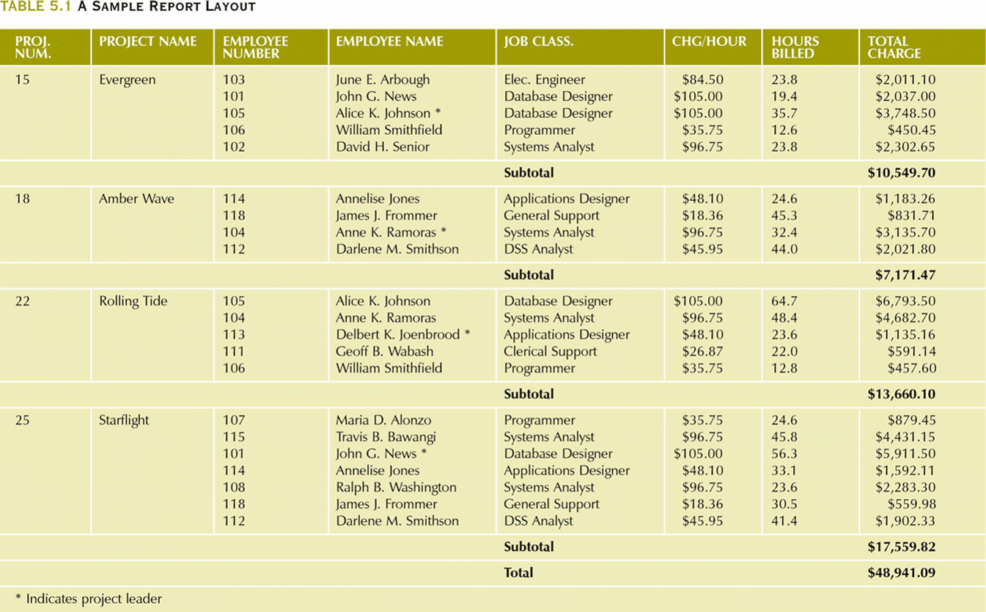
The Need for Normalization
Example: company that manages building projects
  Charges its clients by billing hours spent on each contract
  Hourly billing rate is dependent on employee’s position

Slide 11
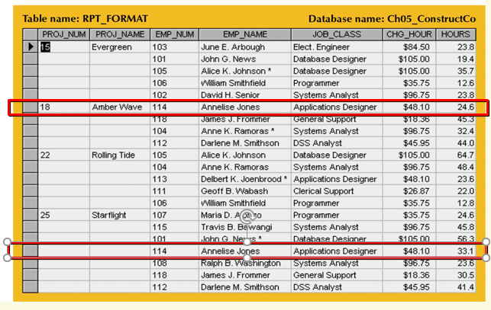
A Table in the Report Format

Slide 12
Functional Dependencies
Functional dependencies (FDs) are used to specify formal measures of the "goodness" of relational designs
A set of attributes X functionally determines a set of attributes Y if the value of X determines a unique value for Y
X →Y holds if whenever two tuples have the same value for X, they must have the same value for Y
  If t1[X]=t2[X], then t1[Y]=t2[Y] in any relation instance r(R)
a constraint on all relation instances r(R)
FDs are derived from the real-world constraints on the attributes
  SSN → ENAME
  PNUMBER → {PNAME, PLOCATION}
  {SSN, PNUMBER} → HOURS
  what if LHS is a key?
A FD X → Y is a
  Full functional dependency if removal of any attribute from X means the FD does not hold any more; otherwise it’s a Partial dependency
  Transitive functional dependency- if there a set of attributes Z that are neither a primary or candidate key and both X→ Z and Z → Y holds.

Slide 13
Inference Rules for FDs
Given a set of FDs F, we can infer additional FDs that hold whenever the FDs in F hold
Armstrong's inference rules
  A1. (Reflexive) If Y subset-of X, then X → Y
  A2. (Augmentation) If X → Y, then XZ → YZ
  (Notation: XZ stands for X U Z)
  A3. (Transitive) If X → Y and Y → Z, then X → Z
A1, A2, A3 form a sound and complete set of inference rules

Slide 14
First Normal Form
Tabular format in which:
  All key attributes are defined
  There are no repeating groups in the table
  All attributes are dependent on primary key
Disallows composite attributes, multivalued attributes, and nested relations;
1NF deals with the “shape” of the tables

Slide 15
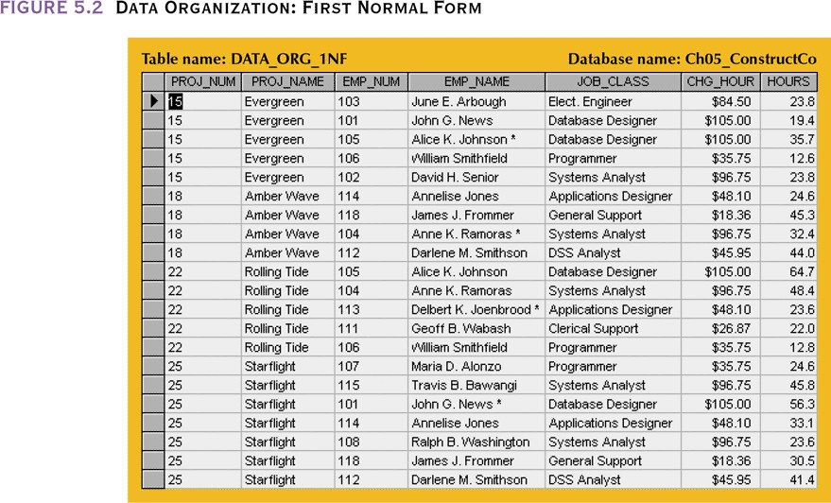
Transform to 1NF
Step 1: Eliminate repeating groups
Step 2: Identify primary key
(Step 3: Identify all dependencies)

Slide 16
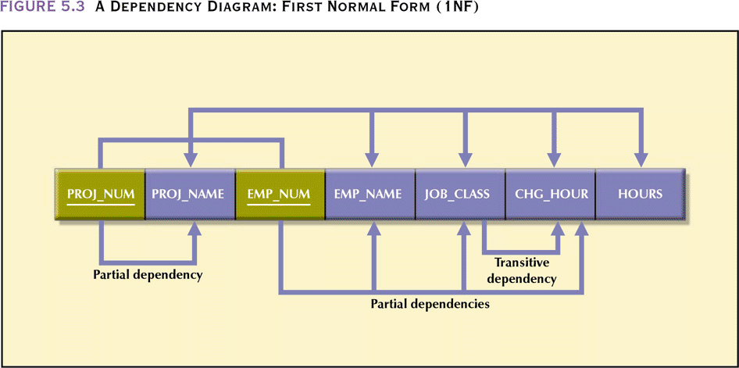
A Dependency Diagram

Slide 17
Second Normal Form
Table is in second normal form (2NF) if:
  It is in 1NF and
  It includes no partial dependencies:
    No attribute is dependent on only a portion of the primary key = every attribute A not in PK is fully functionally dependent on PK
2NF deals with the relationship between non-key and key attributes

Slide 18
Conversion to Second Normal Form
Relational database design can be improved by converting the database into second normal form (2NF)
Two steps
  Step 1: Write each key attribute on separate line, and then write the original (composite) key on the last line; Each component will become the key in a new table
  Step 2: Determine which attributes are dependent on which other attributes (remove anomalies)

Slide 19
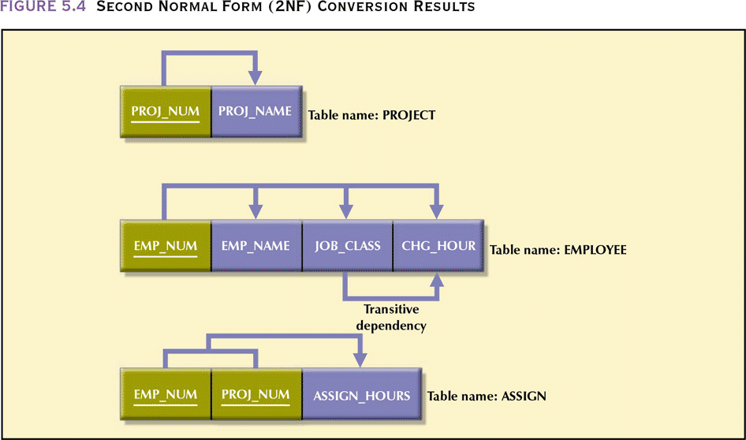
Second Normal Form (2NF)
Conversion Results

Slide 20
Third Normal Form
A table is in third normal form (3NF) if:
  It is in 2NF and
  It contains no transitive dependencies
3NF removes transitive dependencies

Slide 21
Conversion to Third Normal Form
Data anomalies created are easily eliminated by completing three steps
  Step 1: find new fact: For every transitive dependency X-Y, write fact Z as a PK for a new table where X->Z and Z->Y
  Step 2: Identify the Dependent Attributes - Identify the attributes dependent on each Z identified in Step 1 and identify the dependency; Name the table to reflect its contents and function
  Step 3: Remove X->Y from Transitive Dependencies

Slide 22
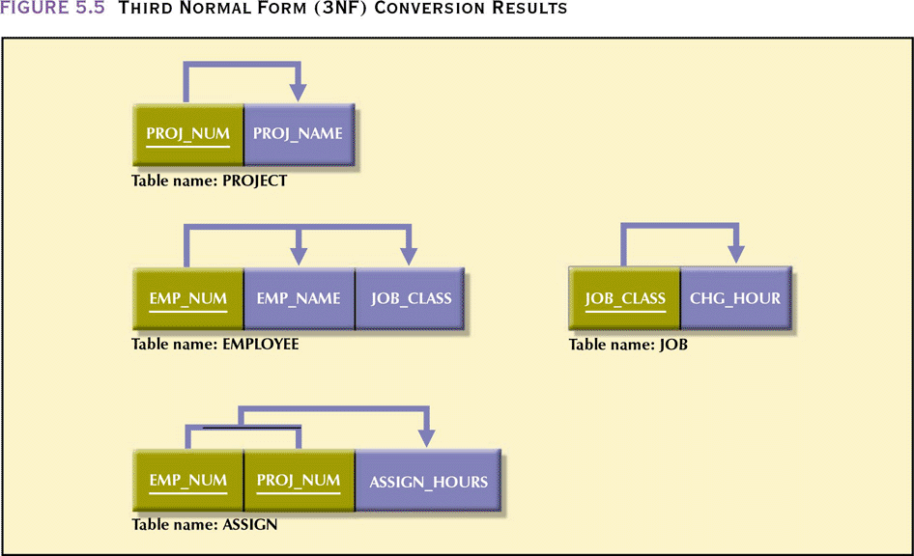
Third Normal Form (3NF)
Conversion Results
data depends on the key [1NF], the whole key [2NF] and nothing but the key [3NF]

Slide 23
BCNF (Boyce-Codd Normal Form)
A relation schema R is in Boyce-Codd Normal Form (BCNF), aka 3.5NF, if whenever an FD X → A holds in R, then X is a superkey of R
  Each normal form is strictly stronger than the previous one:
    Every 2NF relation is in 1NF
    Every 3NF relation is in 2NF
    Every BCNF relation is in 3NF
  There exist relations that are in 3NF but not in BCNF
  The goal is to have each relation in BCNF (or 3NF)
  Why not 4NF? 4 and 5NF deal with multi-valued attributes
  Just slightly stricter than 3NF

Slide 24
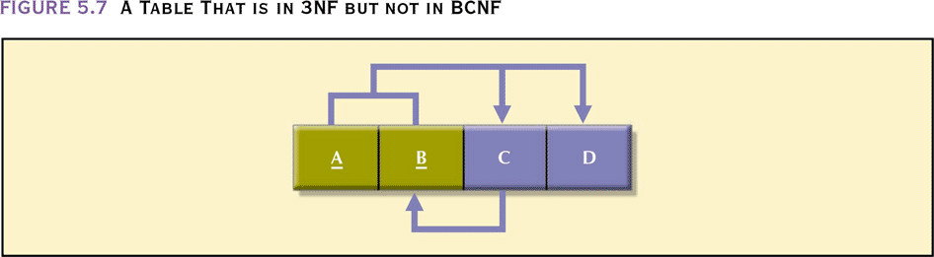
A Table That is in 3NF but not in BCNF

Slide 25
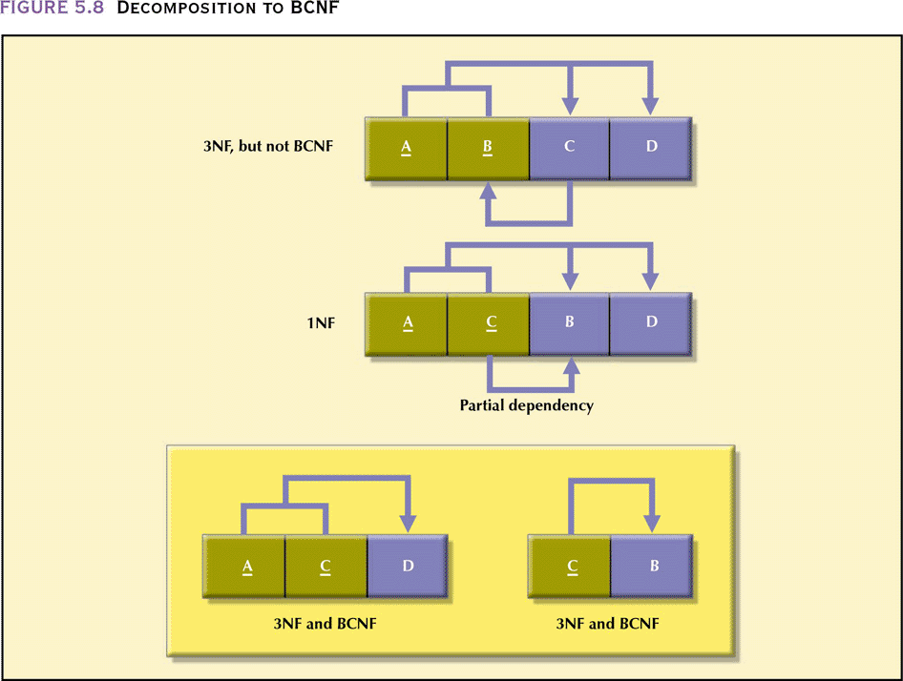
Decomposition to BCNF

Slide 26
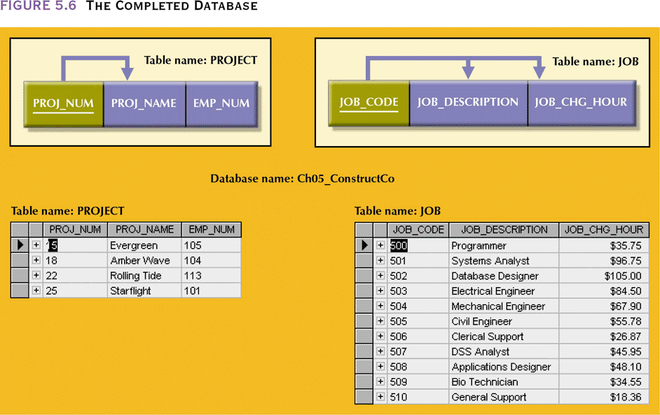
The Completed Database

Slide 27
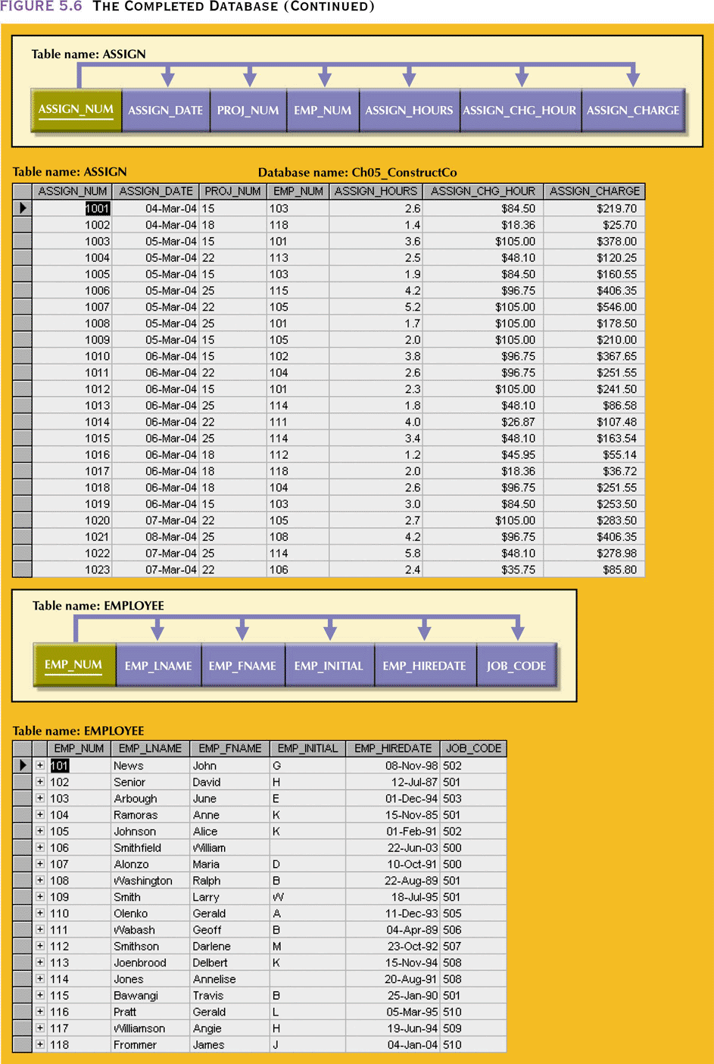
The Completed Database (continued)

Slide 28
Relational Algebra
Notes:
1

Slide 29
Relational Query Languages
Query languages: Allow manipulation
and retrieval of data from a database.
Relational model supports simple, powerful QLs:
  Strong formal foundation based on logic.
  Allows for much optimization.
Query Languages != programming languages!
  QLs not expected to be “Turing complete”.
  QLs not intended to be used for complex calculations.
  QLs support easy, efficient access to large data sets.
Notes:
2

Slide 30
Formal Relational Query Languages
Two mathematical Query Languages form the basis for “real” languages (e.g. SQL), and for implementation:
  Relational Algebra: More operational (procedural), very useful for representing execution plans.
  Relational Calculus: Let users describe what they want, rather than how to compute it. (Non-operational, declarative.)

Slide 31
Preliminaries
A query is applied to relation instances, and the result of a query is also a relation instance.
  Schemas of input relations for a query are fixed
  The schema for the result of a given query is also fixed Determined by definition of query language constructs.
Notes:
4

Slide 32
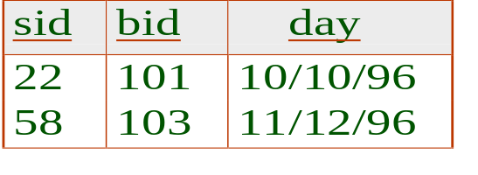
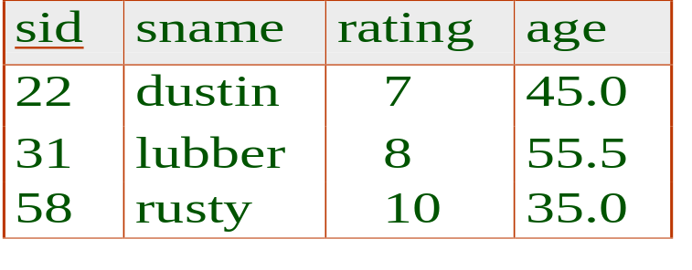
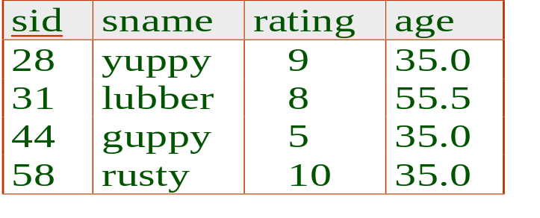
Example Instances
“Sailors” and “Reserves” relations for our examples. “bid”= boats. “sid”: sailors
We’ll use positional or named field notation
R1
S1
S2
Notes:
5

Slide 33
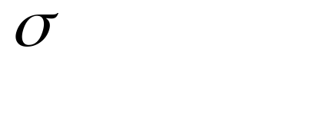
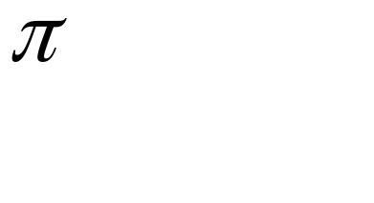


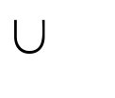
Relational Algebra
Basic operations:
  Selection ( ) Selects a subset of rows from relation.
  Projection ( ) Deletes unwanted columns from relation.
  Cross-product ( ) Allows us to combine two relations.
  Set-difference ( ) Tuples in reln. 1, but not in reln. 2.
  Union ( ) Tuples in reln. 1 and in reln. 2.
Additional operations:
  Intersection, join, division, renaming: Not essential, but (very!) useful.
Since each operation returns a relation, operations can be composed! (Algebra is “closed”.)
Notes:
6

Slide 34
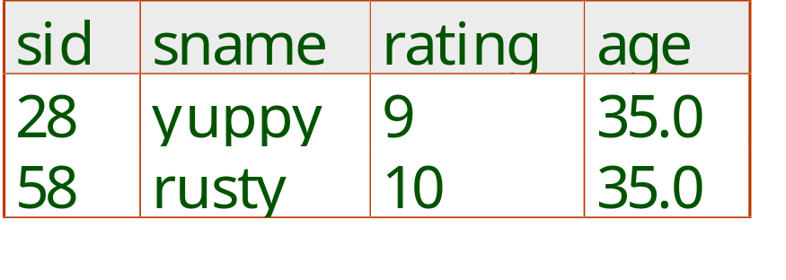
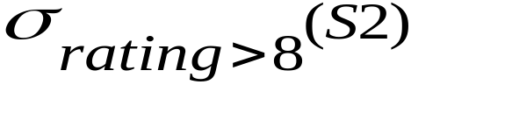
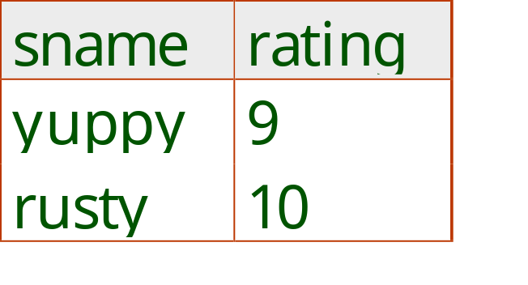
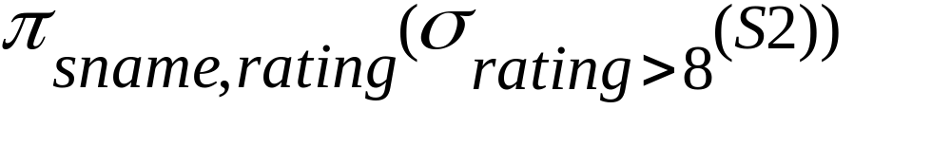
Selection
Selects rows that satisfy selection condition.
Schema of result identical to schema of (only) input relation.
Result relation can be the input for another relational algebra operation (Operator composition.)
Notes:
8

Slide 35
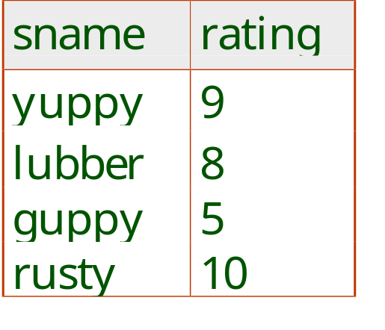
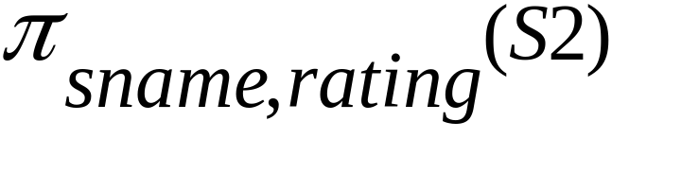
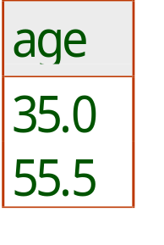
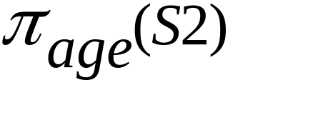
Projection
Deletes attributes that are not in projection list.
Schema of result contains exactly the fields in the projection list, with the same names that they had in the (only) input relation.
Projection operator has to eliminate duplicates! (Why?? what are the consequences?)
Notes:
7

Slide 36
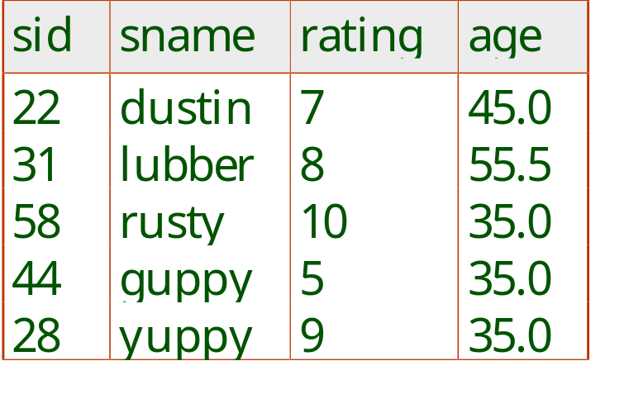
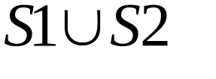
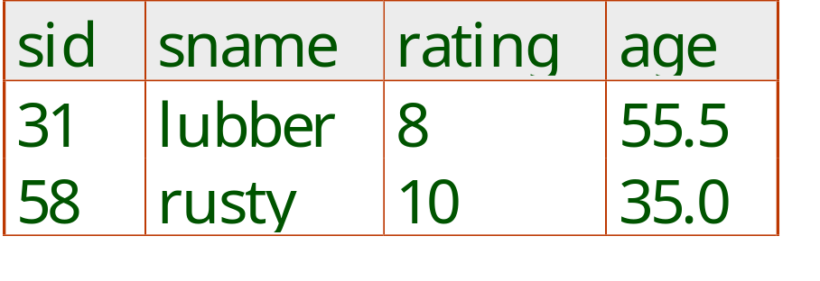
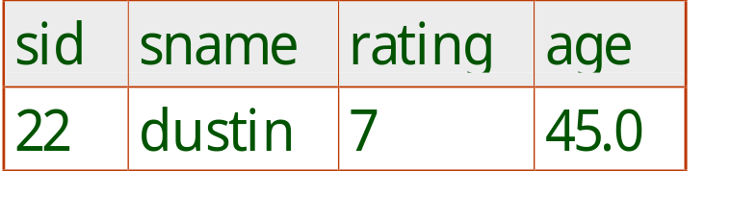

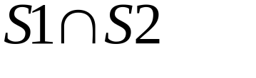
Union, Intersection, Set-Difference
All of these operations take two input relations, which must be union-compatible:
  Same number of fields.
  `Corresponding’ fields have the same type.
What is the schema of result?
Notes:
9

Slide 37
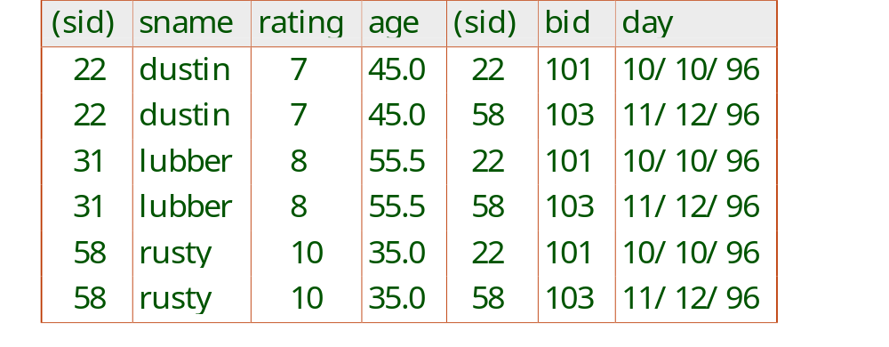
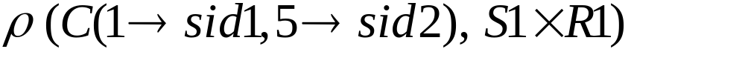
Cross-Product
Each row of S1 is paired with each row of R1.
Result schema has one field per field of S1 and R1, with field names `inherited’ if possible.
  Conflict: Both S1 and R1 have a field called sid.
Renaming operator:
Notes:
10

Slide 38
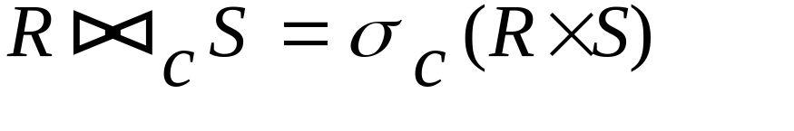
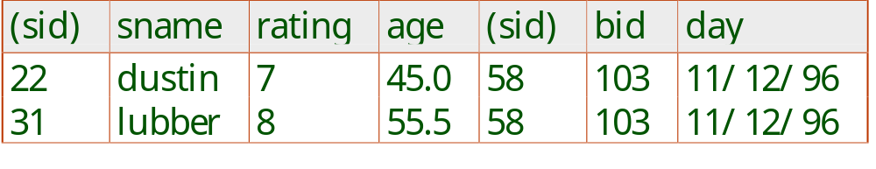
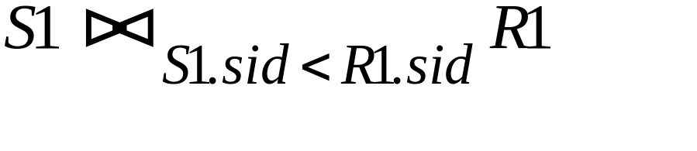
Joins
Condition Join:
Result schema same as that of cross-product.
Fewer tuples than cross-product. Filters tuples not satisfying the join condition.
Sometimes called a theta-join.
Notes:
11

Slide 39
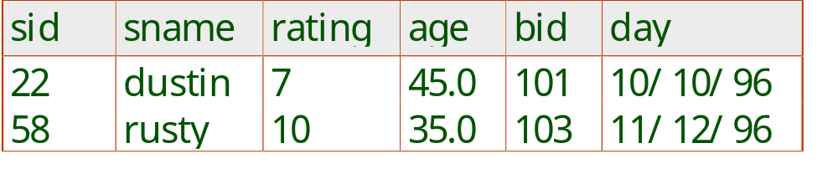
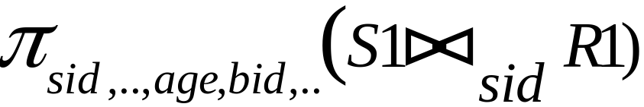
Joins
Equi-Join: A special case of condition join where the condition c contains only equalities.
Result schema similar to cross-product, but only one copy of fields for which equality is specified.
Natural Join: Equijoin on all common fields.
Notes:
12

Slide 40
Division
Not supported as a primitive operator, but useful for expressing queries like: Find sailors who have reserved all boats.
Precondition: in A/B, the attributes in B must be included in the schema for A. Also, the result has attributes A-B.
  SALES(supId, prodId);
  PRODUCTS(prodId);
  Relations SALES and PRODUCTS must be built using projections.
  SALES/PRODUCTS: the ids of the suppliers supplying ALL products.
Notes:
13

Slide 41
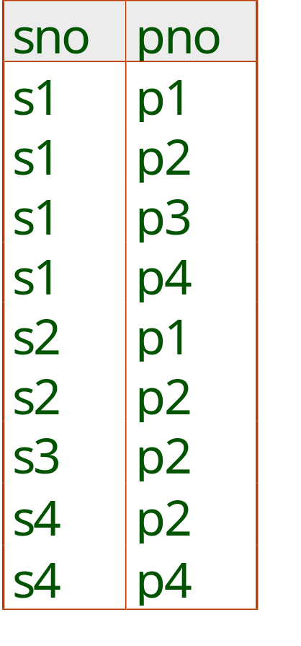
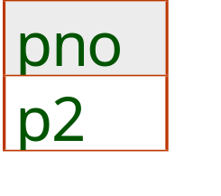
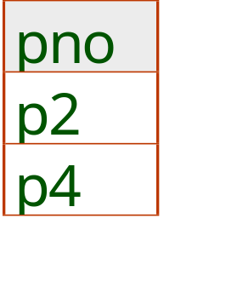
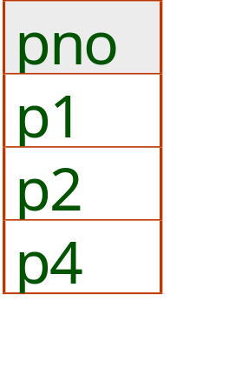
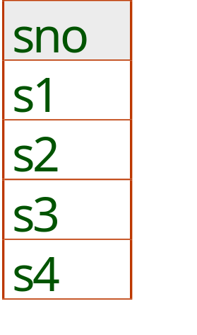
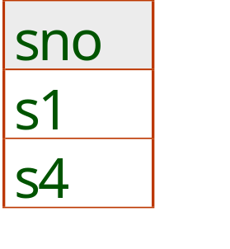
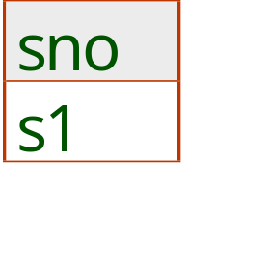
Examples of Division A/B
B1
B2
B3
A
A/B1
A/B2
A/B3
Notes:
14

Slide 42
Expressing A/B Using Basic Operators
Division is not essential op; just a useful shorthand.
  (Also true of joins, but joins are so common that systems implement joins specially. Division is NOT implemented in SQL).
Idea: For SALES/PRODUCTS, compute all products such that there exists at least one supplier not supplying it.
  x value is disqualified if by attaching y value from B, we obtain an xy tuple that is not in C.
The answer is π_{sid}(Sales) - C
Notes:
15

Slide 43
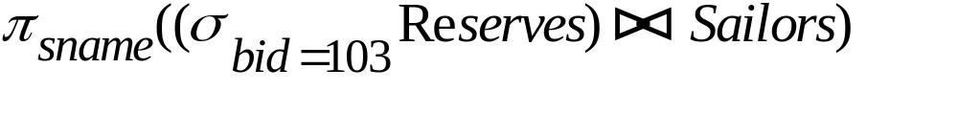
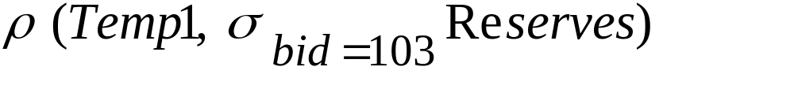
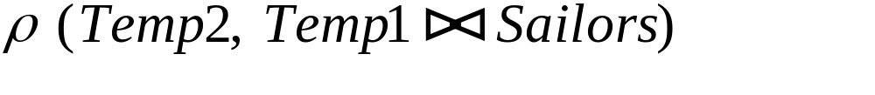
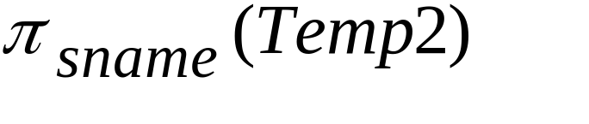
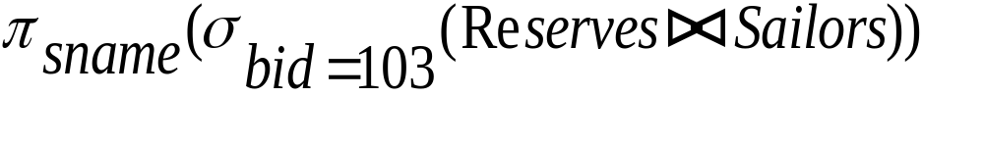
Find names of sailors who’ve reserved boat #103
Solution 1:
Solution 2:
Solution 3:
Notes:
16

Slide 44
Find names of sailors who’ve reserved a red boat
Information about boat color only available in Boats; so need an extra join:
A more efficient solution:
A query optimizer can find this, given the first solution!
Notes:
17

Slide 45




Find sailors who’ve reserved a red or a green boat
Can identify all red or green boats, then find sailors who’ve reserved one of these boats:
Can also define Tempboats using union! (How?)
What happens if is replaced by in this query?
Notes:
18

Slide 46

Find sailors who’ve reserved a red and a green boat
Previous approach won’t work! Must identify sailors who’ve reserved red boats, sailors who’ve reserved green boats, then find the intersection (note that sid is a key for Sailors):
Notes:
19

Slide 47


Find the names of sailors who’ve reserved all boats
Uses division; schemas of the input relations to / must be carefully chosen:
To find sailors who’ve reserved all ‘Interlake’ boats:
.....
Notes:
20

Slide 48

Summary
RDBMS design process
  Normalization
  the normal forms 1NF, 2NF, 3NF, BCNF
  normal forms transformation
DBMS architectures
Next week:
  Beyond relational data
  XML: Extensible Markup Language
  RDF: Resource Description Framework

